Slide 1
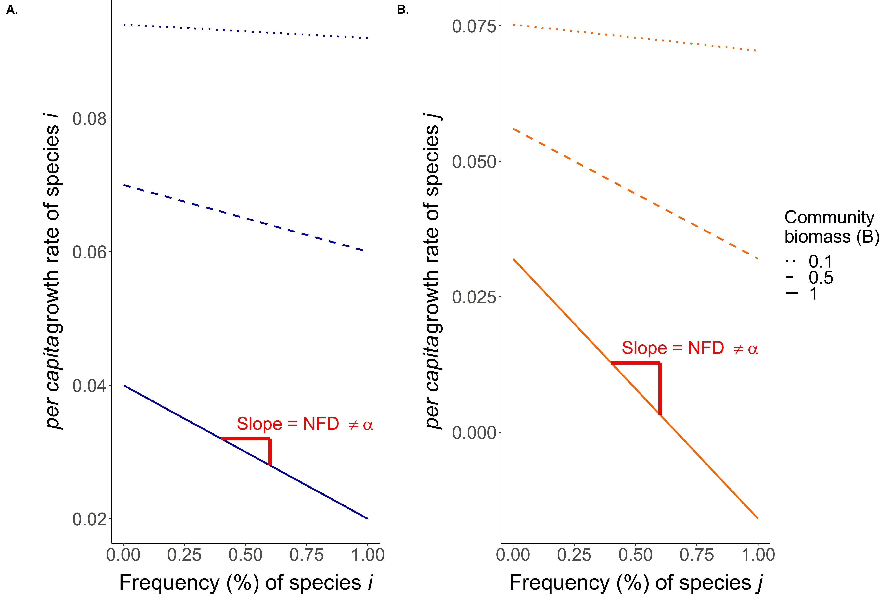
Figure 1

Slide 2
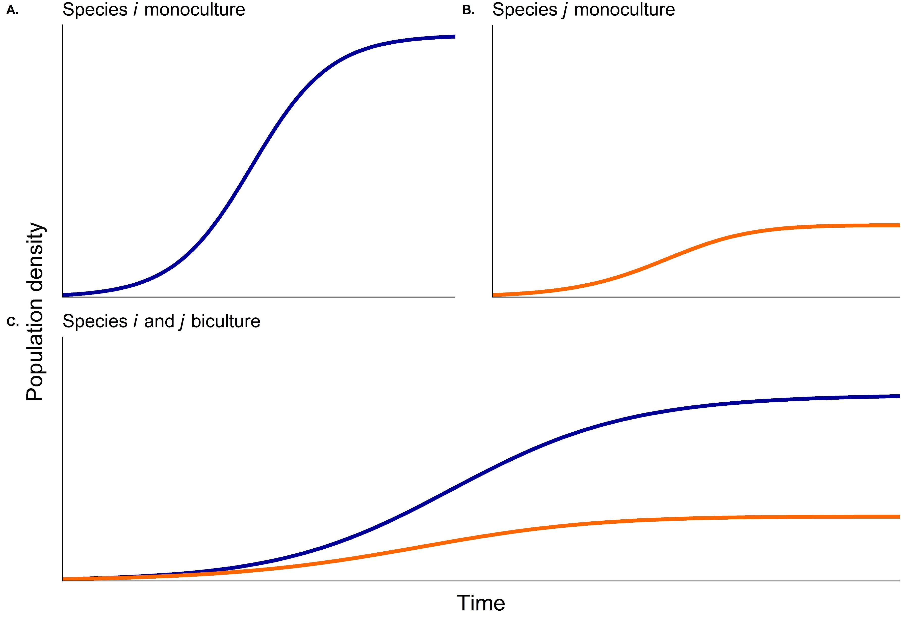
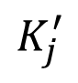
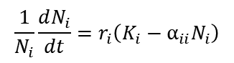
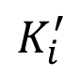
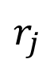
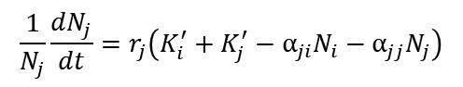
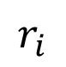
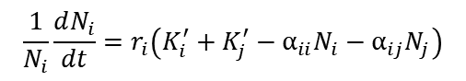
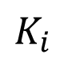
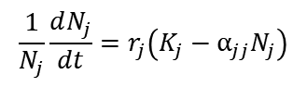
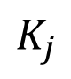
Figure 2
$$K_{i}$$
$$K_{j}$$
$$r_{i}$$
$$r_{j}$$
$$\frac{1}{N_{i}}\frac{dN_{i}}{dt}=r_{i}\left(K_{i}−α_{ii}N_{i}\right)$$
$$\frac{1}{N_{j}}\frac{dN_{j}}{dt}=r_{j}\left(K_{j}−α_{jj}N_{j}\right)$$
$$K_{i}^{′}$$
$$\frac{1}{N_{i}}\frac{dN_{i}}{dt}=r_{i}\left(K_{i}^{′}+K_{j}^{′}−α_{ii}N_{i}−α_{ij}N_{j}\right)$$
$$K_{j}^{′}$$
$$\frac{1}{N_{j}}\frac{dN_{j}}{dt}=r_{j}\left(K_{i}^{′}+K_{j}^{′}−α_{ji}N_{i}−α_{jj}N_{j}\right)$$

Slide 3
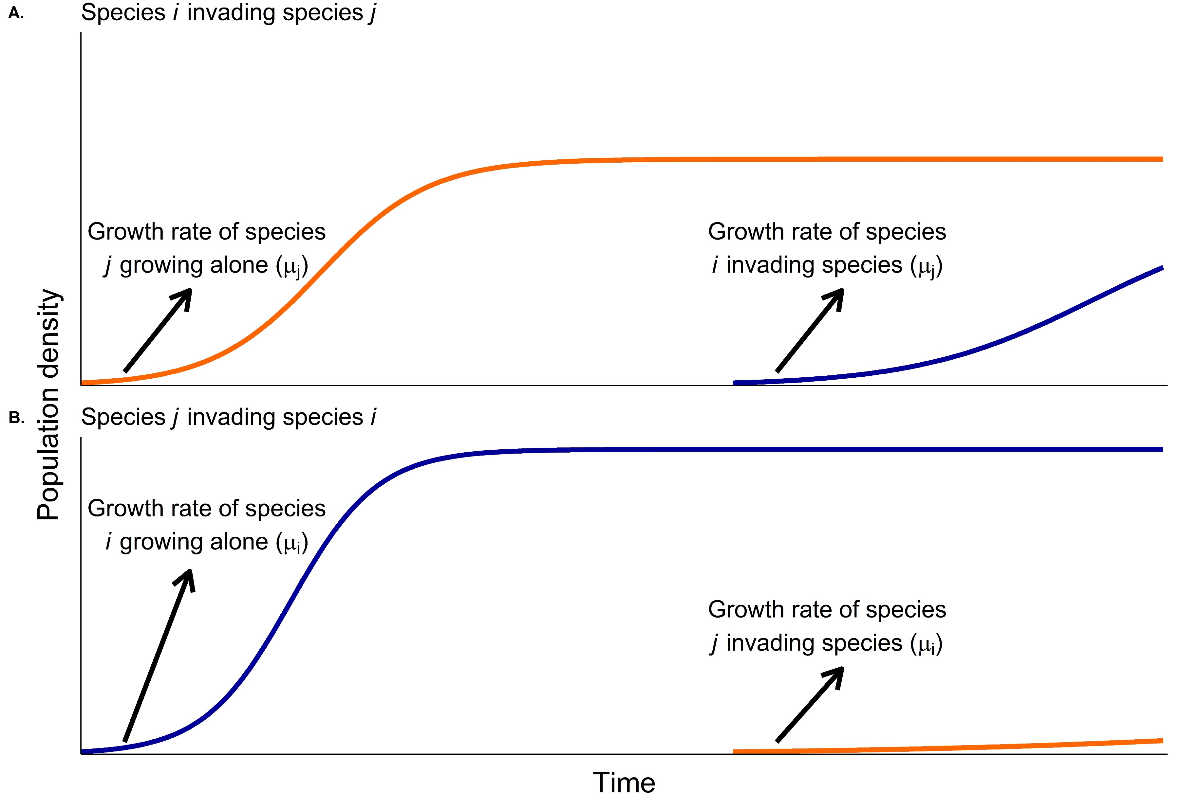
Figure 3

Slide 4
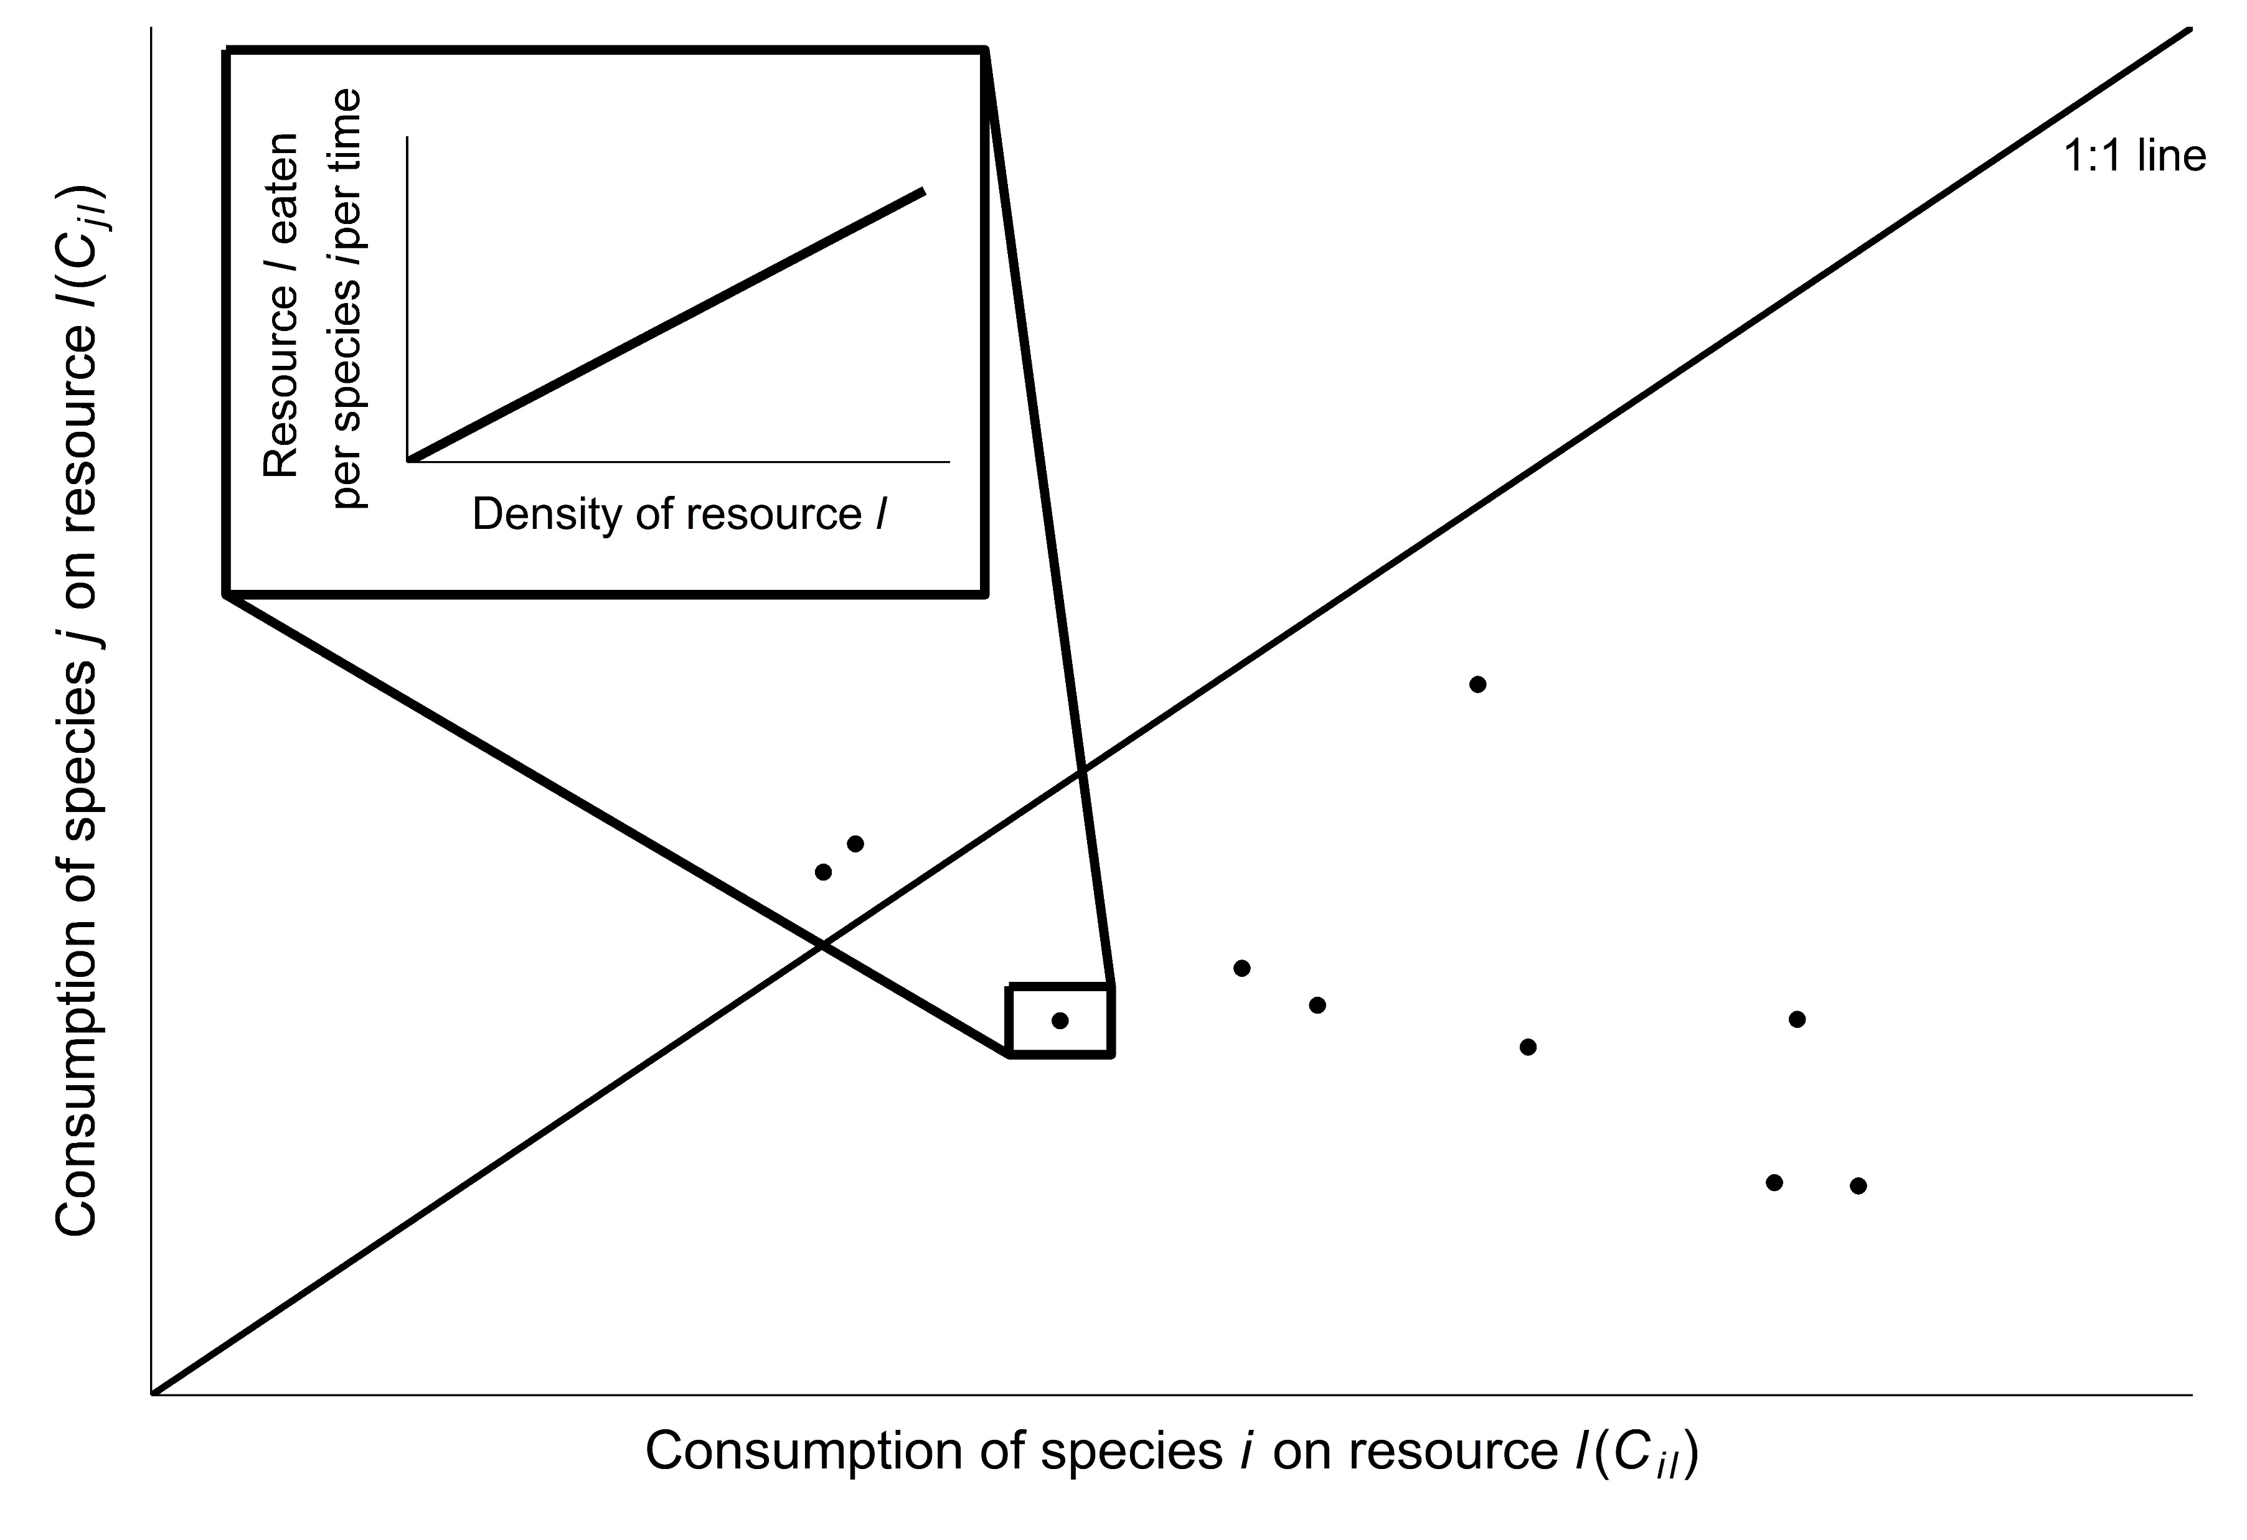
Figure 4

Slide 5
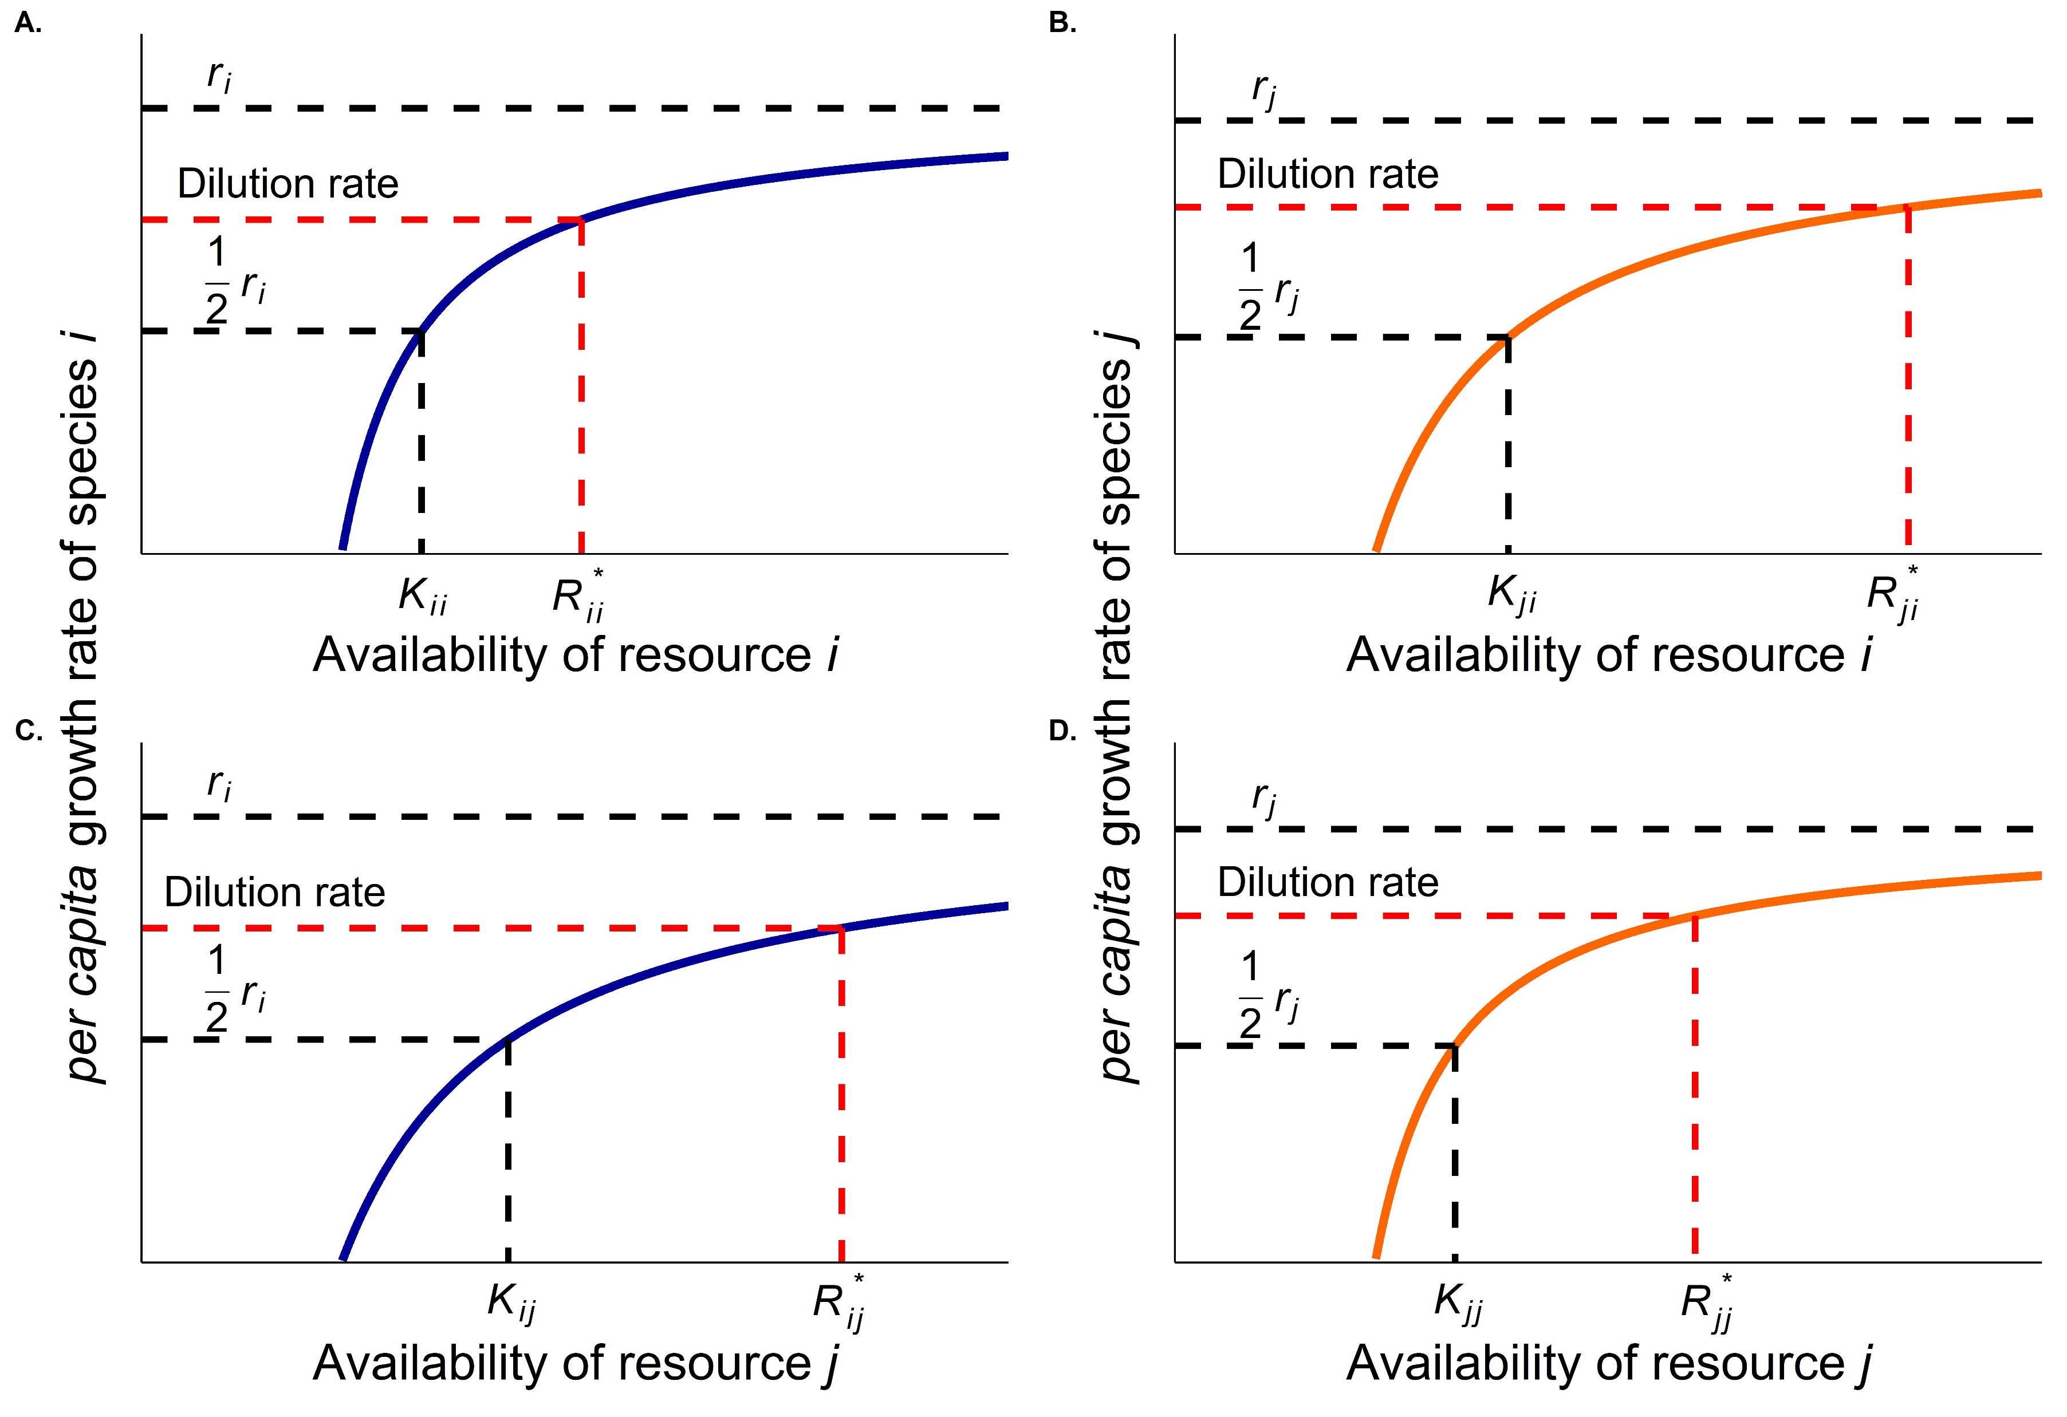
Figure 5

Slide 6
Table 1
Decision steps: | 1: Does the method yield estimates of ND and RFD compatible with Chesson’s inequality? | No |  | Yes | Yes | Yes | Yes
 | 2: Do you know the factors that govern population dynamics? | No |  | No | No | Yes | Yes
 | 3: How will empirical data be obtained? | Experimental or Observational |  | Experimental or Observational | Experimental | Experimental | Experimental
 | 4: Can you have monocultures? | No |  | Yes | Yes | Yes | Yes
 | 5: Can you assume ≥ 1 species is at steady-state? | Yes |  | No | Yes | No | No
 | 6: The resource is: | Not explicit |  | Not explicit or biotic (dynamic) | Not explicit | Biotic (dynamic) | Abiotic
 | 7: Need a method for predicting pairwise coexistence among ≥ 2 species? | Yes |  | No | Yes | Yes | No
Method |  | Negative frequency dependence |  | Lotka-Volterra | Sensitivity | MacArthur’s CRM | Tilman’s CRM
 | Foundational paper for model | Rees and Westoby 1997 |  | Volterra 1928 | MacArthur 1970 | MacArthur 1970 | Tilman 1977
 | Theoretical paper linking model to MCT | Adler et al 2007 |  | Chesson 2000 | Carrol et al 2011 | Chesson 1990 | Letten 2017
 | Empirical paper using model for MCT | Levine and HilleRisLambers 2009 |  | Godoy and Levine 2014 | Narwani et al 2013 | none | Letten 2017
Experimental Requirements | Requires invasion from rare? | no |  | no | yes | no | no
 | How many mixtures of species A and B? | ≥2 |  | ≥1 | 2 | no | no
 | Are time-series required? | yes, short |  | yes, long | yes, short | no | no
 | How many experiments required for pairwise predictions for n species | m*n*(n-1), where m≥2 |  | n+[n(n-1)/2] | n(n-1) | 2n | 2n
Outputs | Can the method predict coexistence for new combinations of species? | no |  | no | no | yes | yes
 | Can the method predict coexistence under different environment? | no |  | no | no | yes, some | yes, some

Slide 7
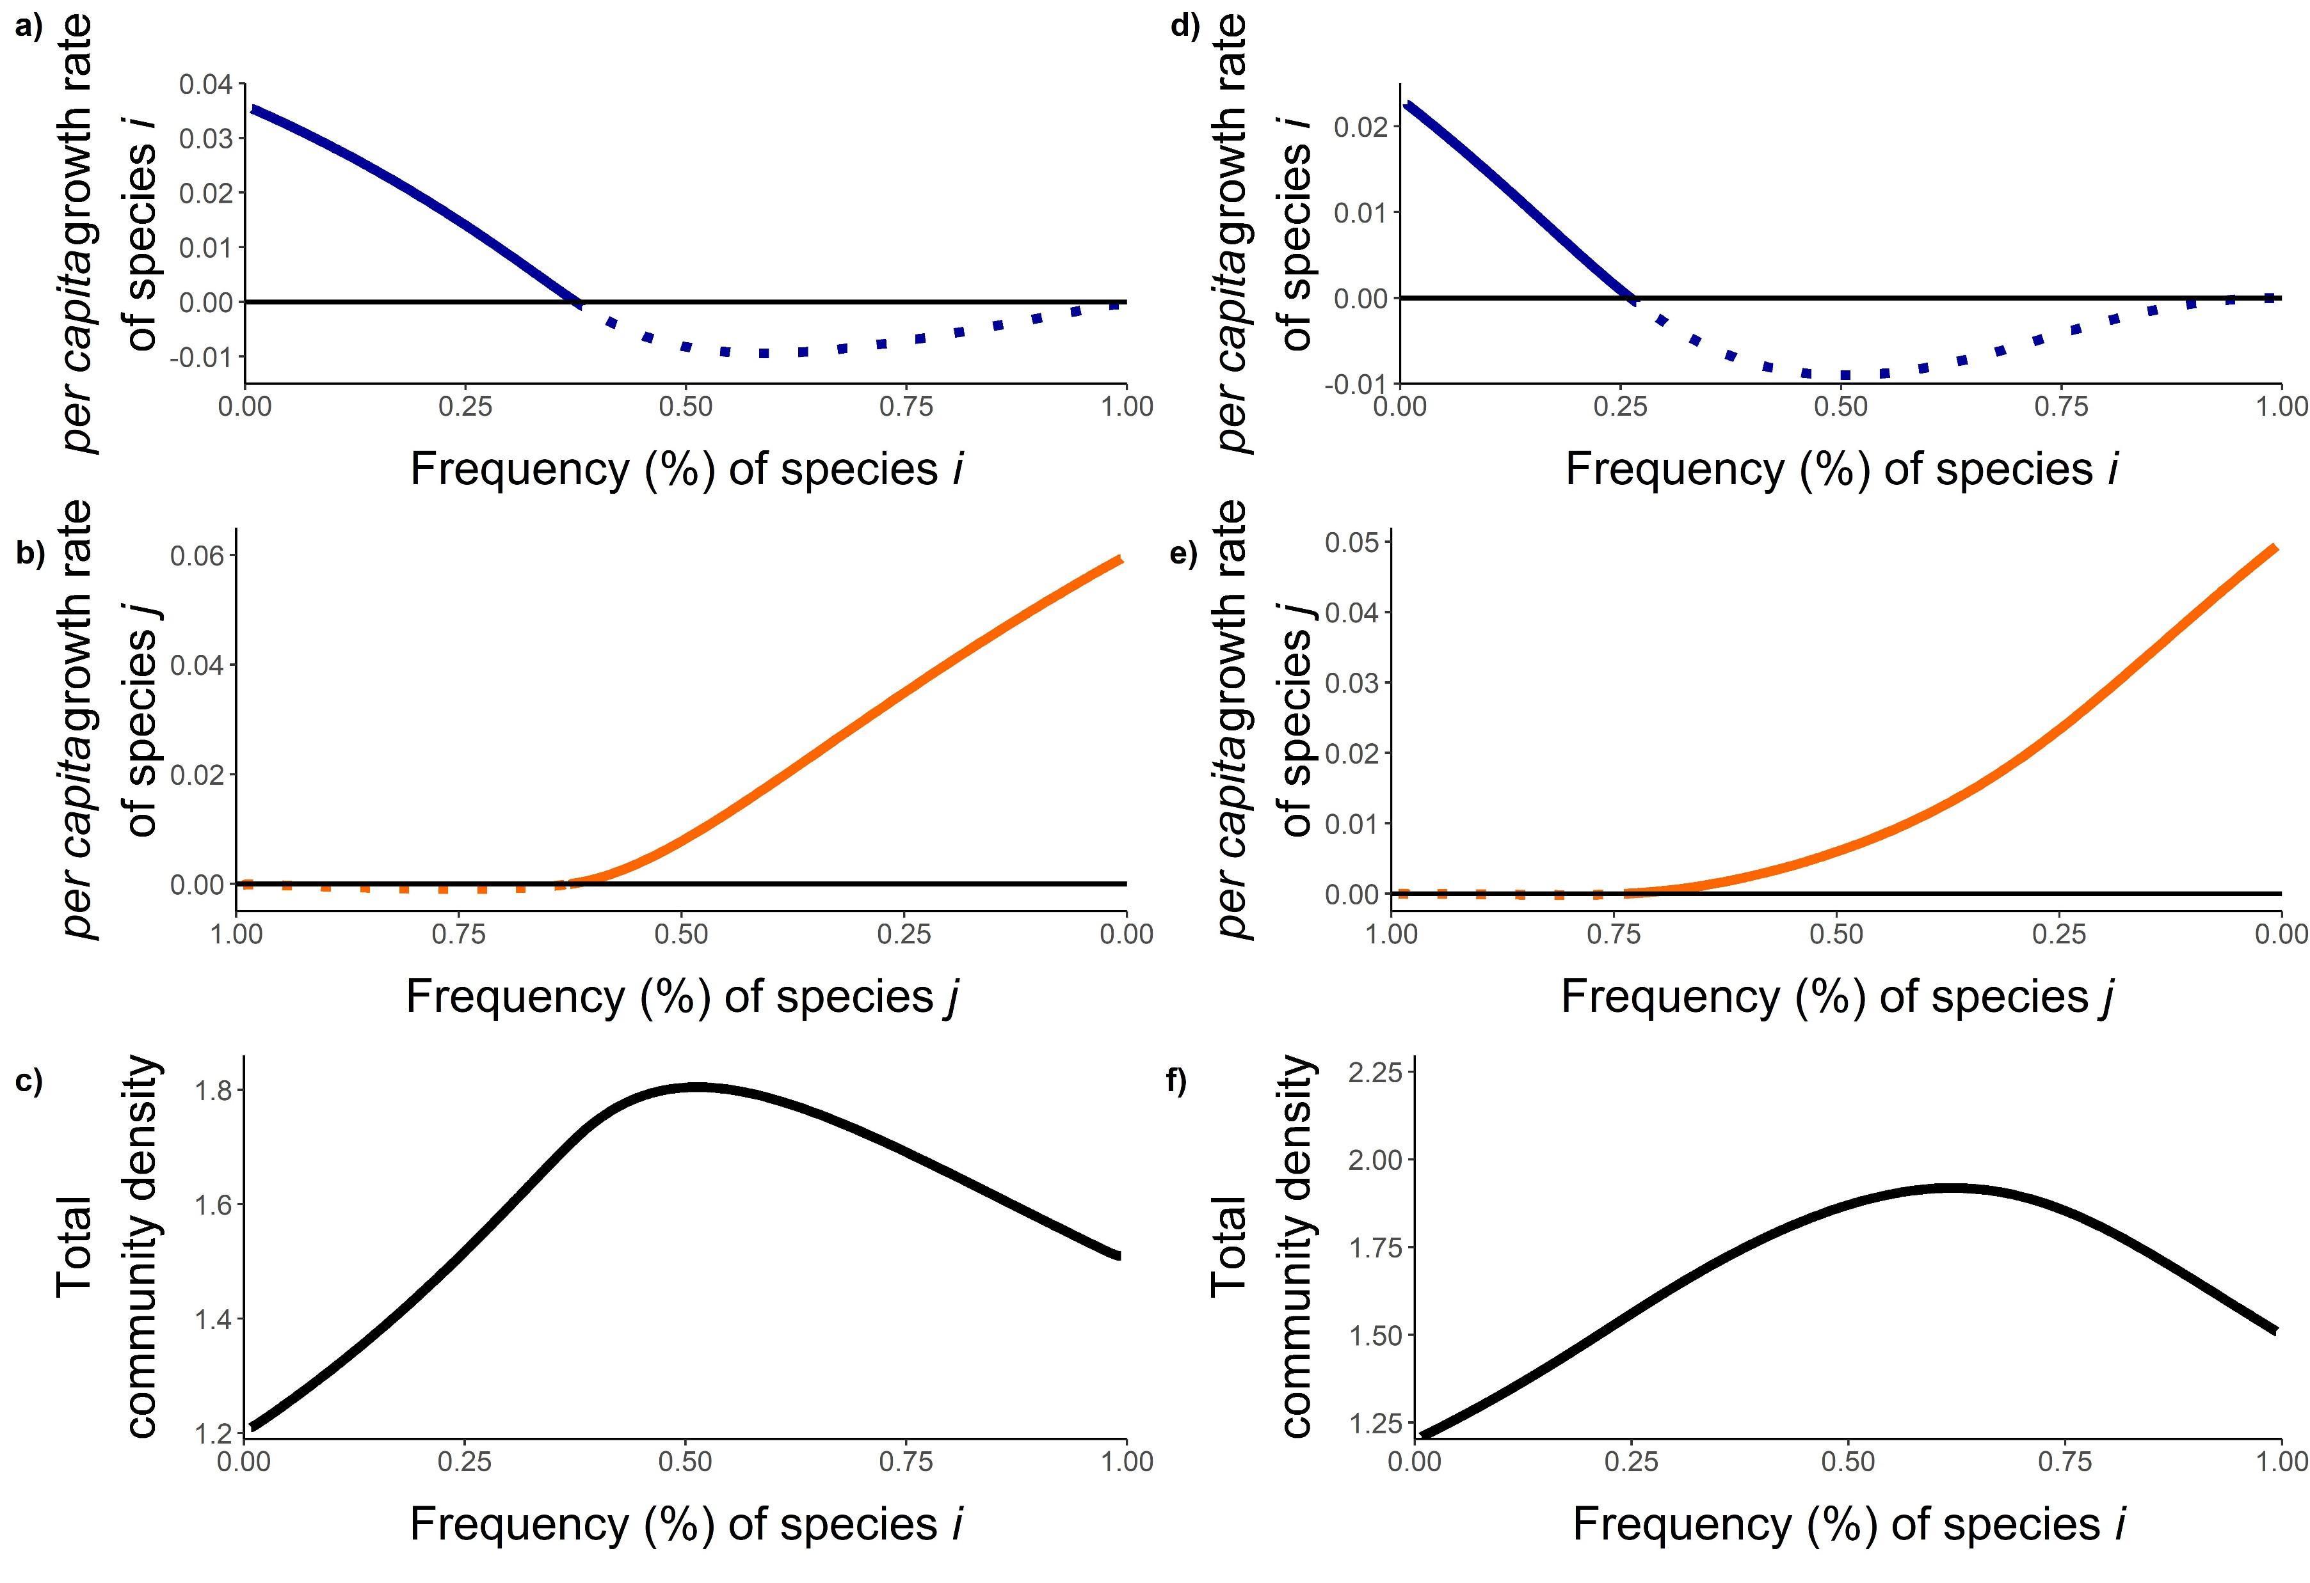
Figure S1

Slide 8
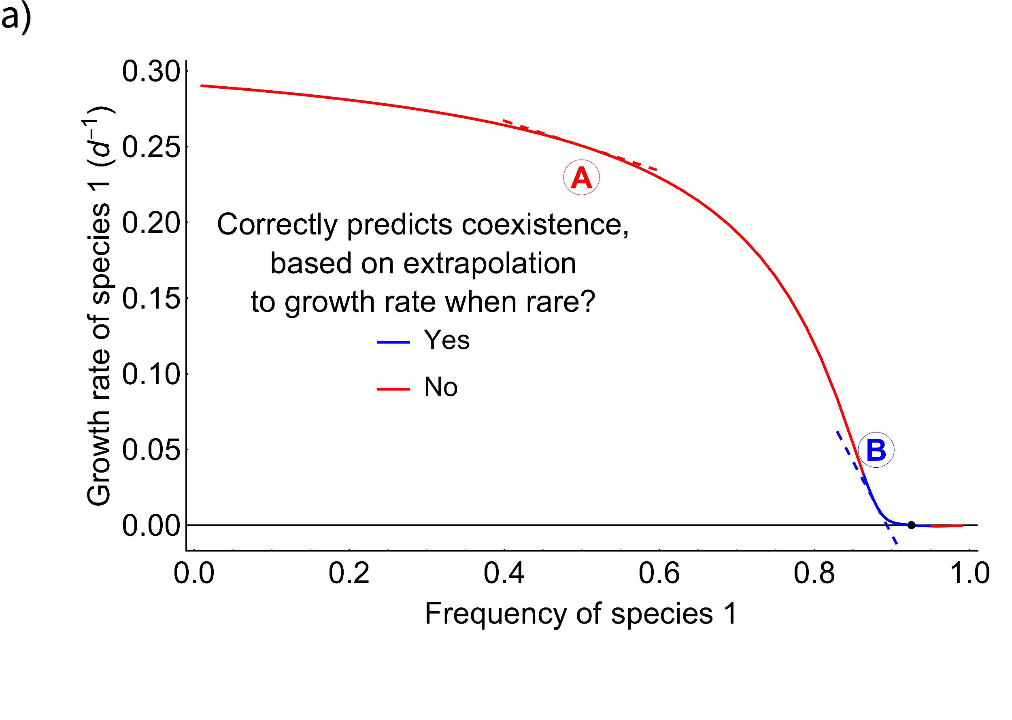
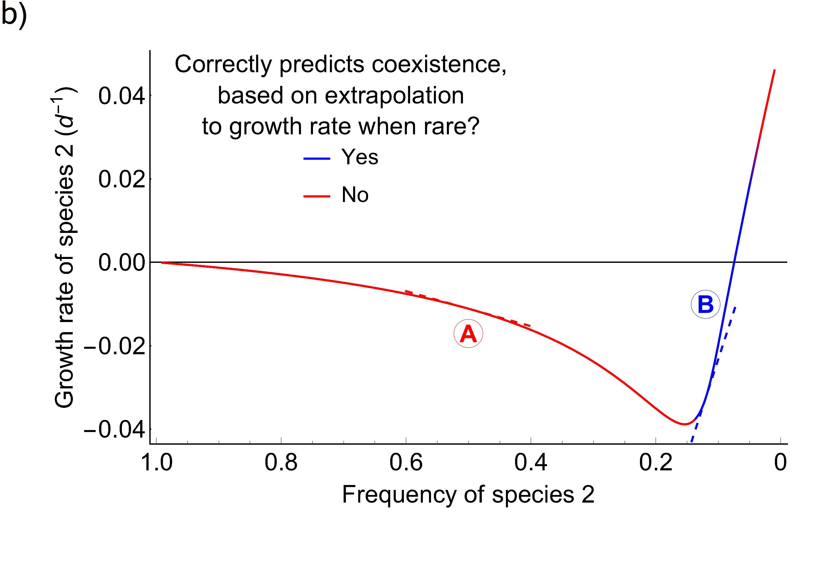
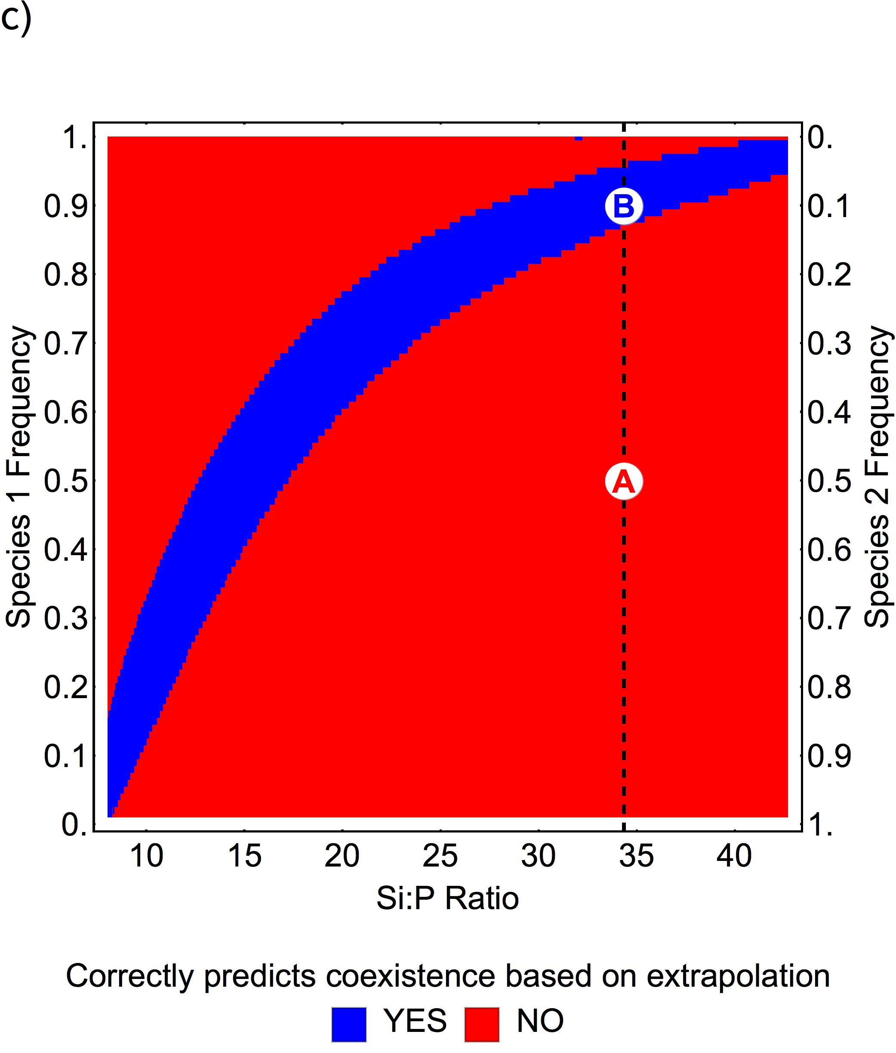
Figure S2

Slide 9
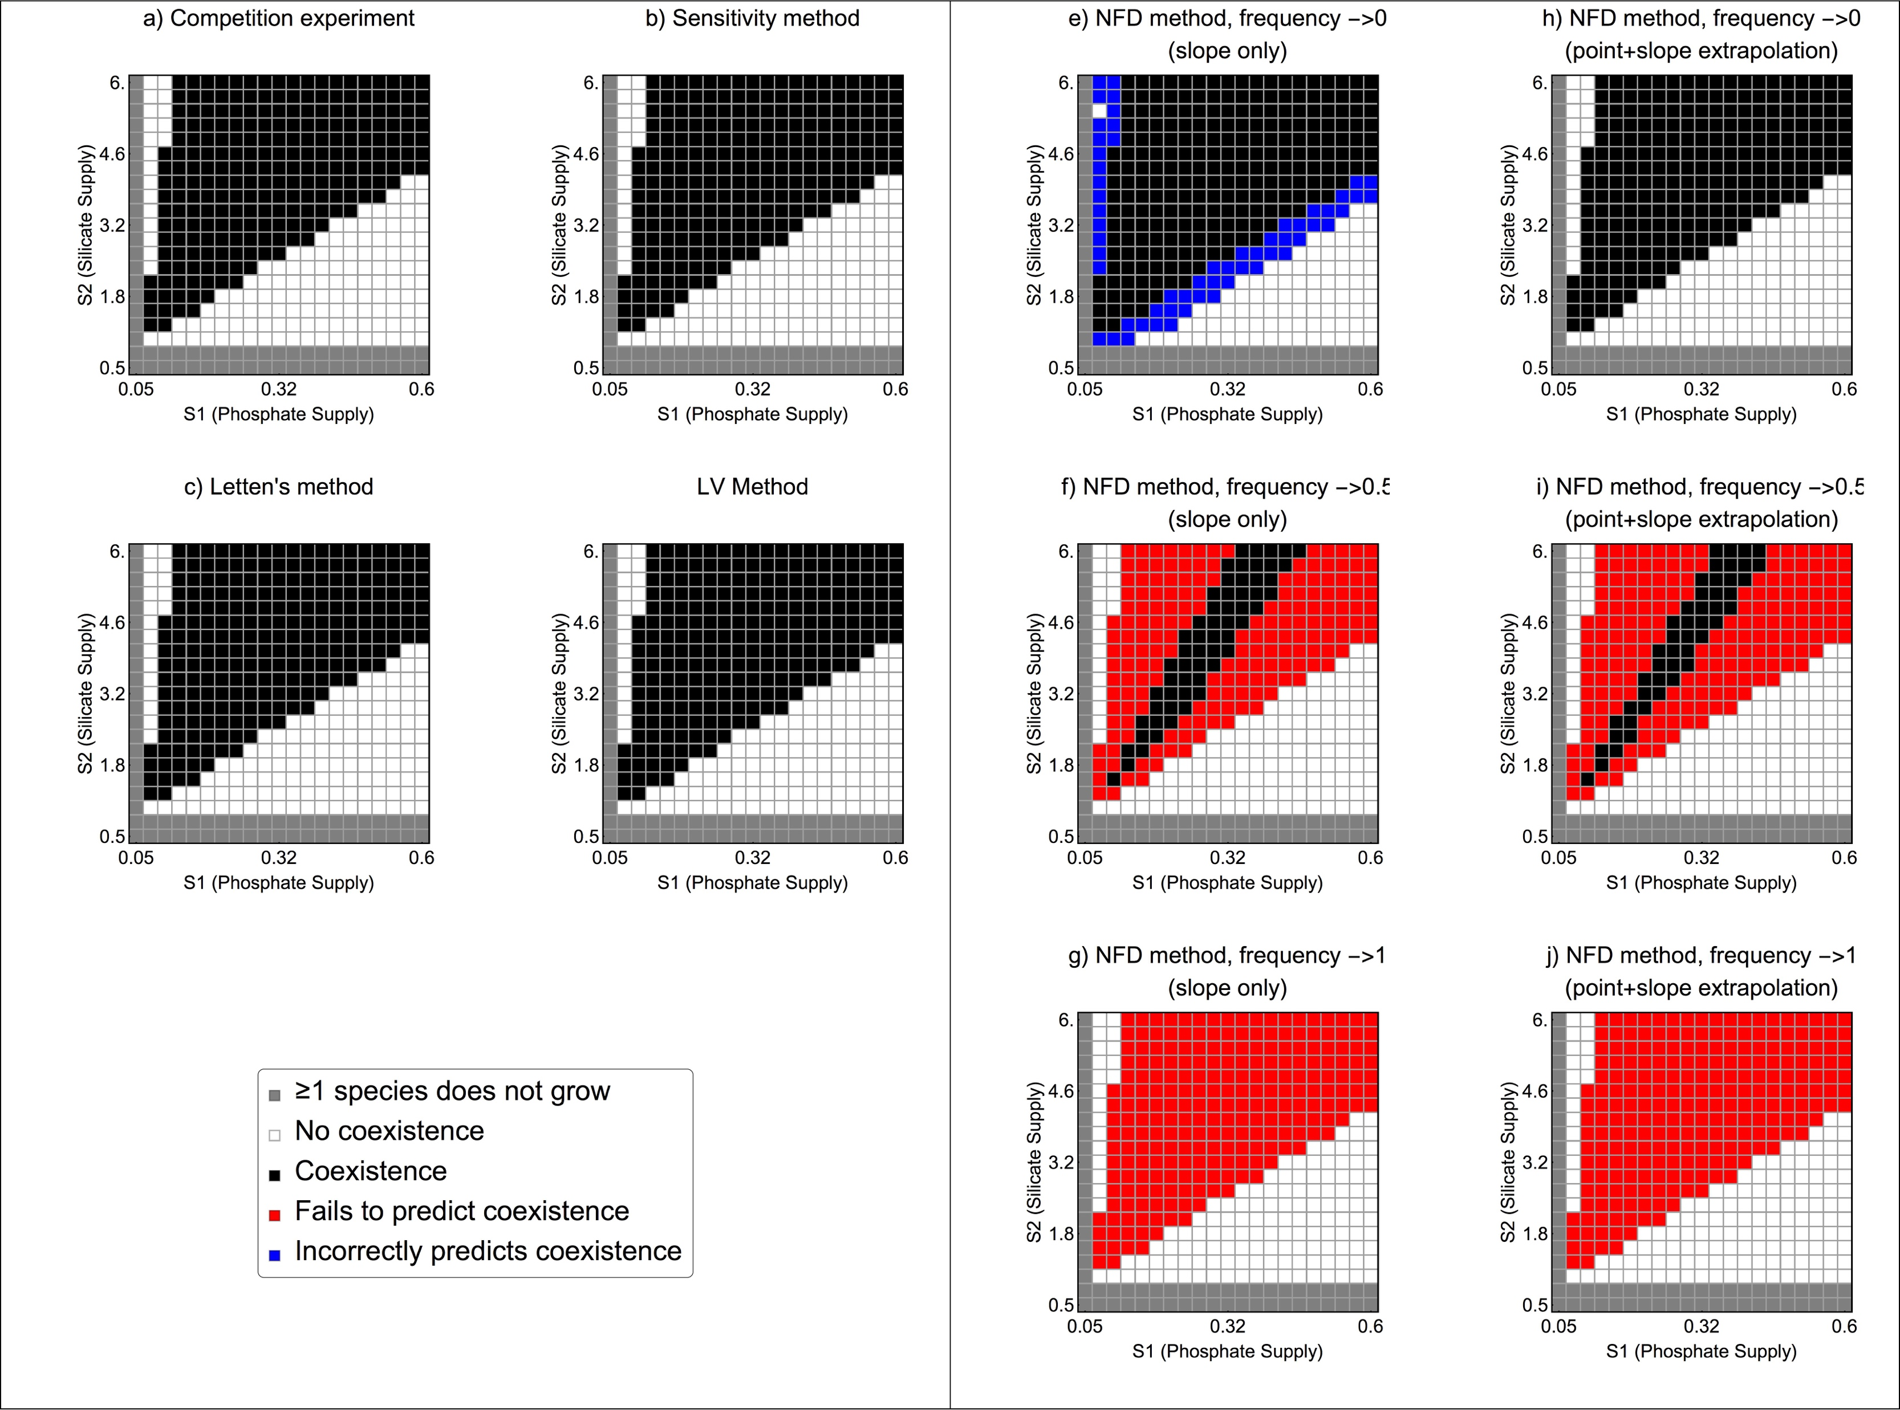
Figure S3

